Slide 1
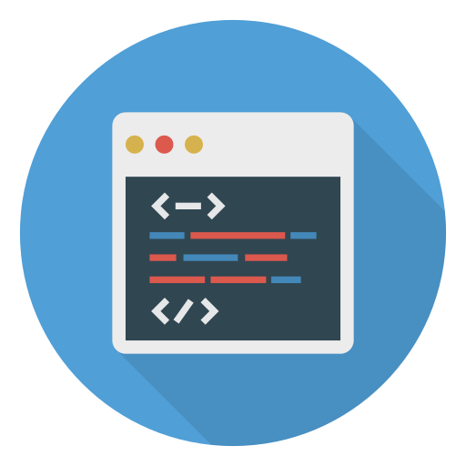
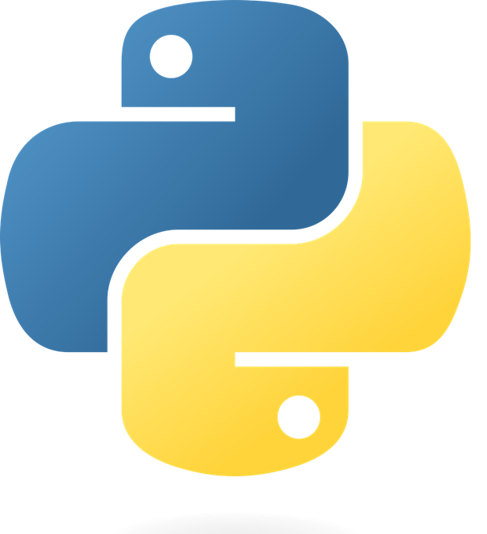
Python in Education
Noelia Vazquez

Slide 2
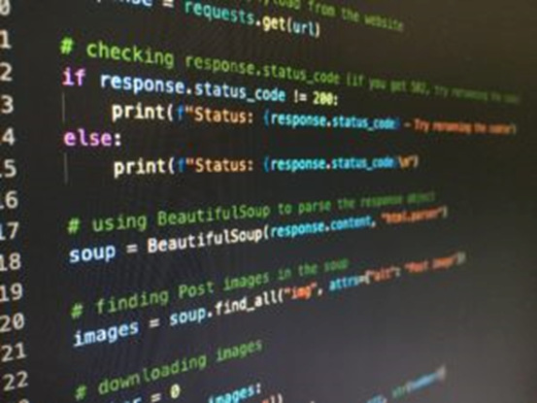
What is Python?
Python is a beginner-friendly object-oriented programming language
Originally created in 1991 by Guido van Rossum
Was re-released as Python 3 in 2008
Just last year, 2021, Python was the world’s most popular programming language

Slide 3
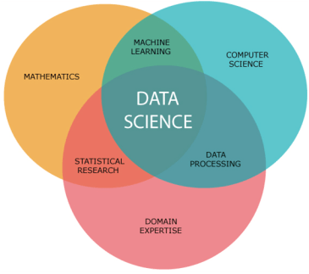
Different Uses for Python
Since Python is such a simple language, there are many different uses such as:
Back-End Web Development
Back-end deals functions and databases that store user information
Some popular web frameworks include: Django, Flask, and Pyramid
Data Science and Analytics
The use of technology and analytics to draw business insights from big data.
96% of respondents in a survey said they use Python at least occasionally for data science.
Python is used to build complex machine learning algorithms that can handle large volumes of data since the language is simple and scalable.
Notes:
Django: allows programmers to launch new apps or sites in hours
Flask: an API that streamlines and simplifies the buildup of web apps
Pyramid: helps apps scale and stay functional no matter how much they grow

Slide 4
Different Uses for Python (cont’d)
Machine Learning and Artificial Intelligence
Python is the number-one programming language for machine learning
It has libraries specific for machine learning: SciKit-Learn, Tensorflow, MlPy
Scientific Computing
Using computers to solve real-world problems in science or engineering fields
Used widely alongside MATLAB to develop mathematical models
Task Automation
Python is an ideal scripting language due to its simple syntax and readability
It has multiple scripting features already built into it
FInance
Python is simple enough that even non-tech professionals use it to handle tasks such as analyzing trends and predicting stock values.
Notes:
SciKit-Learn: Simplifies the interface of machine learning algorithms
Tensorflow: Builds advanced neural networks for companies like DropBox and Google
MIPy: Predicts outcomes by analyzing patterns

Slide 5
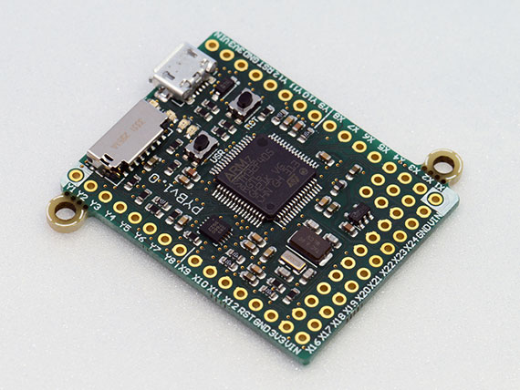
Why Python?
Code Readability
Code is easy to read and write since it almost looks like English
There are less symbols (;, {}) which makes it more forgiving
Has a Large Collection of Resources
New programmers wouldn’t have to code everything from scratch thanks to pre-written packages or modules already available within Python
Cross-Platform
Any operating system can run Python
It can even run on Raspberry Pis and microcontrollers

Slide 6
References
How is python used in education? Python Central. (2021, December 29). Retrieved October 12, 2022, from https://www.pythoncentral.io/how-is-python-used-in-education/
Ntoll. (n.d.). 5 reasons why python is a popular teaching language. O'Reilly Radar. Retrieved October 12, 2022, from http://radar.oreilly.com/2015/04/five-reasons-why-python-is-a-popular-teaching-language.html
Team, M. B. (2021, December 7). What is python used for? MOOC.org. Retrieved October 10, 2022, from https://www.mooc.org/blog/what-is-python-used-for#:~:text=A%20reported%2071%25%20of%20educators,commands%20and%20more%20time%20coding.

